Slide 1
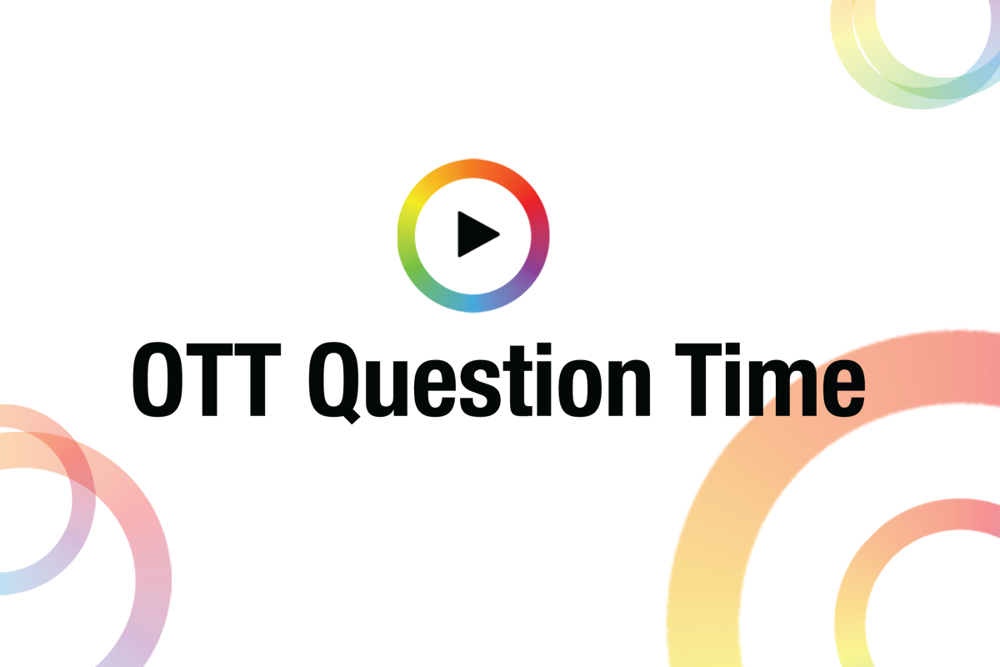
OTTQT #3: The Pandemic & The Advertising Paradox

Slide 2
major broadcasters usually have four main revenue streams
Digital
(OTT ads + SVOD)
Content Production
Which form a virtuous circle.
The more that produced content is monetised – via linear and digital advertising – or sold to SVOD aggregators or other broadcasters, channels and platforms (across territories), the more money can be reinvested into content. This model has worked well for years.
Broadcasters
Linear Advertising
Content Distribution

Slide 3
and for most major broadcasters, overall revenues are still rising
TOTAL REVENUE (local currencies -- billions) | 2013 | 2014 | 2015 | 2016 | 2017 | 2018 | Variance
ITV | 2,389 | 2,590 | 2,972 | 3,064 | 3,132 | 3,211 | 34.41%
CBS | 12,713 | 12,519 | 12,671 | 13,166 | 13,692 | 14,514 | 14.17%
RTL Group | 5,824 | 5,808 | 6,029 | 6,237 | 6,373 | 6,505 | 11.69%
Discovery | 5,535 | 6,265 | 6,394 | 6,497 | 6,873 | 10,553 | 90.66%
Viacom | 13,794 | 13,783 | 13,268 | 12,488 | 13,260 | 12,940 | -6.19%
Channel 4 | 908 | 938 | 979 | 995 | 960 | 975 | 7.38%
TV4 (Sweden) | 4,204 | 4,206 | 4,234 | 4,314 | 4,469 | 4,739 | 12.73%
Average Increase |  |  |  |  |  |  | 23.55%

Slide 4
problem is, linear ad revenues are declining…
LINEAR REVENUE (local currencies -- billions) | 2013 | 2014 | 2015 | 2016 | 2017 | 2018 | Variance
SRG SSR (Switzerland) | 248 | 260 | 243 | 231 | 215 | 202 | -22.79%
ITV | 1,542 | 1,629 | 1,719 | 1,672 | 1,591 |  | 3.08%
CBS | 7,525 | 7,204 | 5,824 | 6,288 | 5,753 | 6,195 | -21.47%
Discovery (International Networks) | 1,162 | 1,483 | 1,353 | 1,279 | 1,332 | 1,765 | 34.16%
Viacom | 4,855 | 4,953 | 5,007 | 4,809 | 4,862 | 4,751 | -2.19%
CBC | 365 | 491 | 333 | 253 | 301 | 318 | -14.57%
Channel 4 |  | 819 | 860 | 854 | 798 | 791 | -3.54%
Average Decrease |  |  |  |  |  |  | -3.90%
Note: Discovery’s huge linear ad revenue growth in 2018 followed the Group’s acquisition of Scripps Network.
Not including the acquisition, Discovery reported a more modest revenue increase of 2-3%.
ITV amalgamated linear and digital advertising revenue in its 2018 results so a like-for-like number can’t be presented here.

Slide 5
and whilst digital revenues are climbing, they’re not yet growing quickly enough to bridge the gap
DIGITAL REVENUE (local currencies -- millions) | 2013 | 2014 | 2015 | 2016 | 2017 | 2018 | Variance
ITV | 118 | 153 | 188 | 231 | 248 |  | 52.42%
Channel 4 | 61 | 62 | 82 | 102 | 124 | 138 | 55.80%
RTL Group | 233 | 295 | 508 | 670 | 826 | 985 | 76.35%
Average Increase |  |  |  |  |  |  | 61.52%
Note: Of the ten national and international broadcaster’s finances that we studied (CBC, CBS, Channel 4, Discovery, ITV, RTL, SRG SSR, TV4, UKTV and Viacom), only the three above have reported their digital revenues. This suggests that for most broadcasters, digital performance has not been strong enough to merit much publicity – especially in the context of financial statements. Perhaps it’s no coincidence then that in its 2018 financial results, ITV has stopped referring to “Online, Pay and Interactive” as a separate revenue stream.

Slide 6
1.5 This risks stalling the virtuous circle
Digital
(OTT advertising + SVOD)
Content Production
If linear ad revenues continue to decline by, on average, 4% a year, this doesn’t mean that broadcasters have 25 years until the model completely breaks down. Less income may lead to less content production which, in turn, may diminish the depth of broadcaster’s other sales channels.
Broadcasters
Linear Advertising
Content Distribution
X

Slide 7
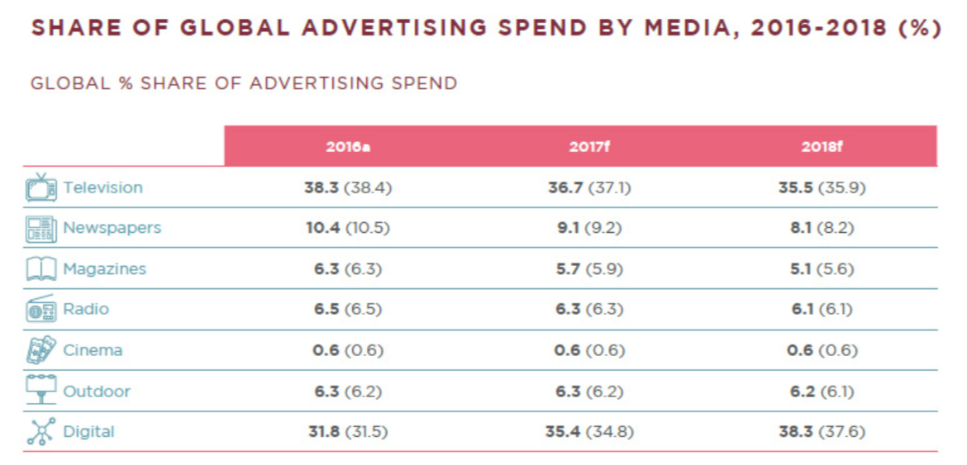
And whilst digital is eating up advertising spend globally…
A study by the global marketing services group, Dentsu Aegis Network, of 59 worldwide markets suggested that in 23 of them, digital became the leading media type in terms of ad spend.
VOD Professional - OTTQT #3: The Pandemic & The Advertising Paradox

Slide 8
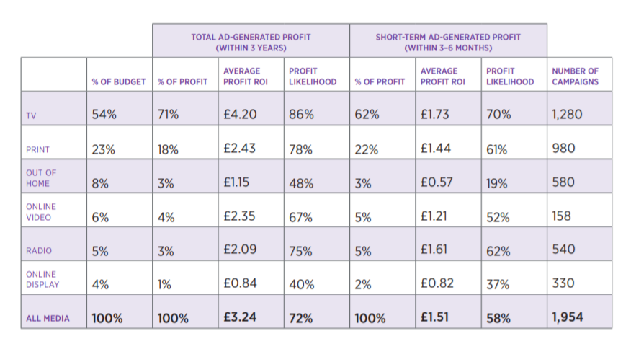
…tv advertising is still incredibly effective
In a 2018 (UK) Ebiquity and Gain Theory study, commissioned by Thinkbox, which analysed 2,000 advertising campaigns across 11 categories to uncover the short and long-term impact of advertising across different media, TV came out top.
VOD Professional - OTTQT #3: The Pandemic & The Advertising Paradox

